Slide 1
Repetition Structures pt. I
while and
do-while
Notes:
Real power of JAVA-- ability to repeat same calc. or sequence of instructions over & over w/o having to rerun progam each time

Slide 2

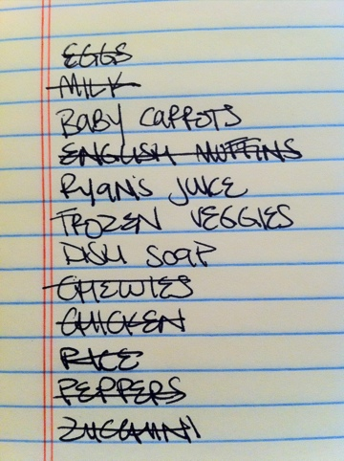
Repetition in Real Life
Notes:
Logic of Rep. structure FAMILIAR TO US

Slide 3
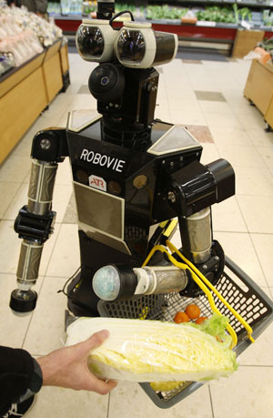
Explaining Repetition to a Robot
While there are more items on my list
purchase next item on list
cross item off list

Slide 4
The while statement-- general form
while (condition)
{
statement;
}
Notes:
Expression:
Evaluates to true or false ---how does compiler interpret?
statement--can be compound CLICK

Slide 5
while with compound statement
while (condition)
{
statement 1;
statement 2;
. . .
statement n;
}
Notes:
Formatting--same as with compound statements encountered before w/
if/else statements
after expression, brace
new line, tab in one space
any number of statements inside braces
Treated as a single statement-- whether you have one statement or a compound statement as part of the while structure, compiler executes following same procedure.
CLICK

Slide 6
while with compound statement
while (condition)
{
statement 1;
statement 2;
. . .
statement n;
}
Code that can change condition
Notes:
Formatting--same as with compound statements encountered before w/
if/else statements
after expression, brace
new line, tab in one space
any number of statements inside braces
Treated as a single statement-- whether you have one statement or a compound statement as part of the while structure, compiler executes following same procedure.
CLICK

Slide 7
int x = 10;
while (x > 0)
{
System.out.println(x) ; x--;
}
System.out.println (“Liftoff!”);

Slide 8

10
9
8
7
6
5
4
3
2
1
Liftoff
Notes:
The Falcon Heavy takes off!

Slide 9
int x = 10;
while (x > 0)
{
System.out.println(x) ; x--;
}
System.out.println (“Liftoff!”);

Slide 10
10
10
10
10
10
10
10
10
10
10 . . .

Slide 11
1
2
3
4
5
6
7
8
9
10
1 to 10

Slide 12
1
2
3
4
5
6
7
8
9
10
int x = 1;
while (x <= 10)
{
System.out.println(x); x++;
}

Slide 13
1
2
4
8
16
32
64

Slide 14
1
2
4
8
16
32
64
int x = 1;
while (x <= 100)
{
System.out.println(x); x *= 2;
}

Slide 15
While Loop Exercise
http://tpcg.io/H37532
Team 0: Christian Barhorst & Jack Nichols & Christopher Loya & Grace Denbow Team 1: Michael Auth & Amanda Walker & Bradford Arick Team 2: David Strawser & Christopher Hohmann & Victor Johnstone Team 3: Sean Brinker & Tirrell Harris & Marcos Perez Team 4: Joseph Armbruster & Laurel Wood & Petya Novakova Team 5: Eric Brink & Joanna Oswald & Kevin Heinkel

Slide 16
While Loop Solutions
http://tpcg.io/QOQROP

Slide 17
The do-while loop
Differs from the while loop in that condition is tested after the body of the loop.
Ensures that program goes through iteration at least one time.

Slide 18
The do-while loop
do
{
statement(s);
}
while (condition);

Slide 19
The do-while loop
do
{
statement(s);
}
while (condition);

Slide 20
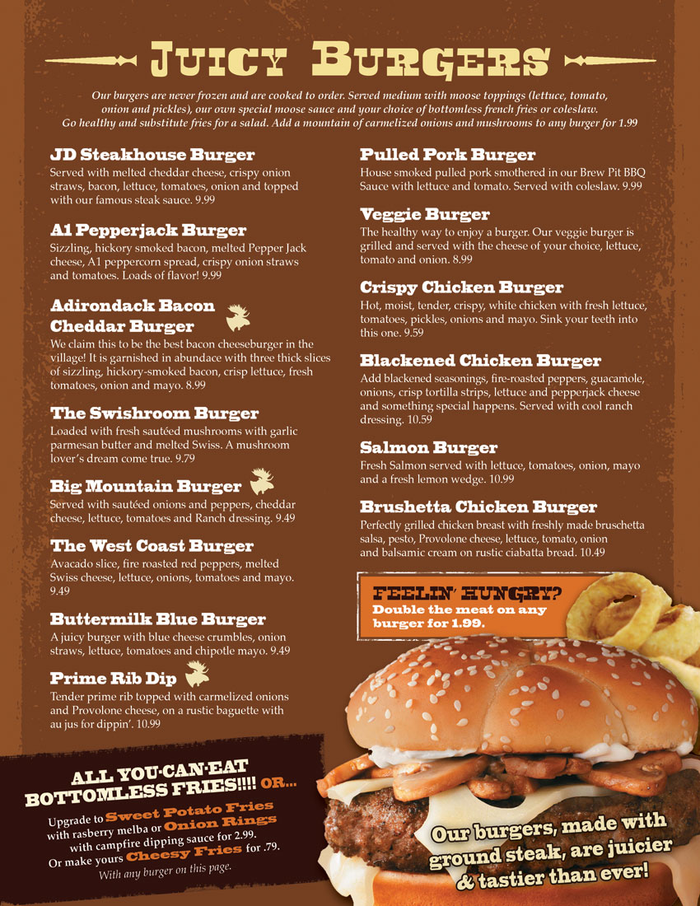
A useful application of do-while: the menu
See
DoLoopMenuDemo.java
http://tpcg.io/9EXYZZ

Slide 21
Review: 3 parts of a while loop
int count = 0; // 1. value initialization
while (count < 10) // 2. termination condition
{
System.out.println (count);
.
.
.
count++; // 3. altering statement
}

Slide 22
The for loop: everything on one line
for (initializing list; terminating condition; altering list)
{
statement(s);
}
for (int count = 1; count <= 10; count++)
{
System.out.println( count);
.
.
.
}
Notes:
3 terms --
middle = expression
if it evaluates to T, statement following is executed
last term--altering list --changes conditions that we seek to test
first term--initialization. Sets initial value for variable we wish to change.
if we don’t, what value is assigned . . .

Slide 23
The for loop
Performs same role as while
All information in a single line
Most useful as a counting loop
Notes:
COUNTING LOOP = Whenever you want to do something a certain number of times. Particularly useful with arrays!!

Slide 24
Converting while statements to for statements
count = 10;
while (count > 0)
{
System.out.println (count);
count--;
}

Slide 25
Answer
for (int count = 10; count > 0; count--)
System.out.println(count);
Notes:
Now rewrite all your while loops as for loops!
Solutions at http://tpcg.io/4T7OPF

Slide 26
Back to breakout rooms!
Convert your while loop challenge solutions to for loops.
Notes:
Solutions available! http://tpcg.io/4T7OPF

